Slide 1
STUDENT MANAGEMENT SYSTEM
Presenting by : Raju Jettappa

Slide 2
INTRODUCTION
Student management System is a system that manages the records of a student .
It’s Designed to help colleges for manage details.
Extensive information is available at your fingertips through this system.
This make easier to navigate and to use maximizing effectiveness of time.

Slide 3
OJECTIVES
Its Provides better and efficient services.
Reduce the workload of college.
Faster way to get information about student.
All details will be available on a click.
There is no need of Paperwork.

Slide 4
MODULES
Main panel
Register as Student
Register as Admin
Login as Admin
Register as Student
Students details
Terms and conditions
Display block

Slide 5
MODULES
Login as Admin
Login Details
Forget password
Forget password
Email id
Security question

Slide 6
Hardware & Software Requirements
Hardware :-
Processor : Pentium or higher
RAM : 1024mb/ 1Gb
Hard Drive : 500Mb or more
Software :-
Operating System : Windows 7,8,10
Language : JAVA

Slide 7


Development Tools & Technology
Development Tools :-
Eclipse IDE
Technology used :-
JDK (java Development kit)

Slide 8
Data flow Diagram
------------------------Files -----------------------
Student management
System
application
Storing All details
Admin
Retrieving details

Slide 9
Data flow Diagram
Student Details
Admin
details
Storing Login details
Storing Admin login details
Storing Student details
------------------------Files ----------------------
Storing Admin details
Storing details
Retrieving login details
Retrieving login details
Retrieving All details
Admin Panel
Add
Search
display
Forget password
Login form

Slide 10
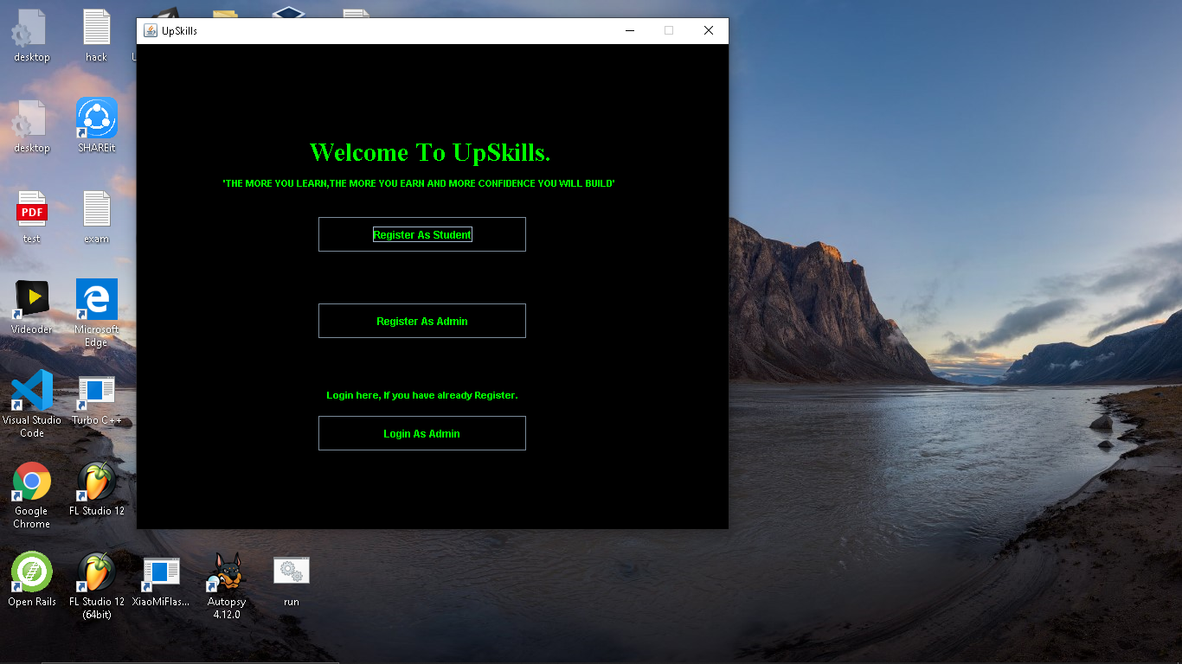
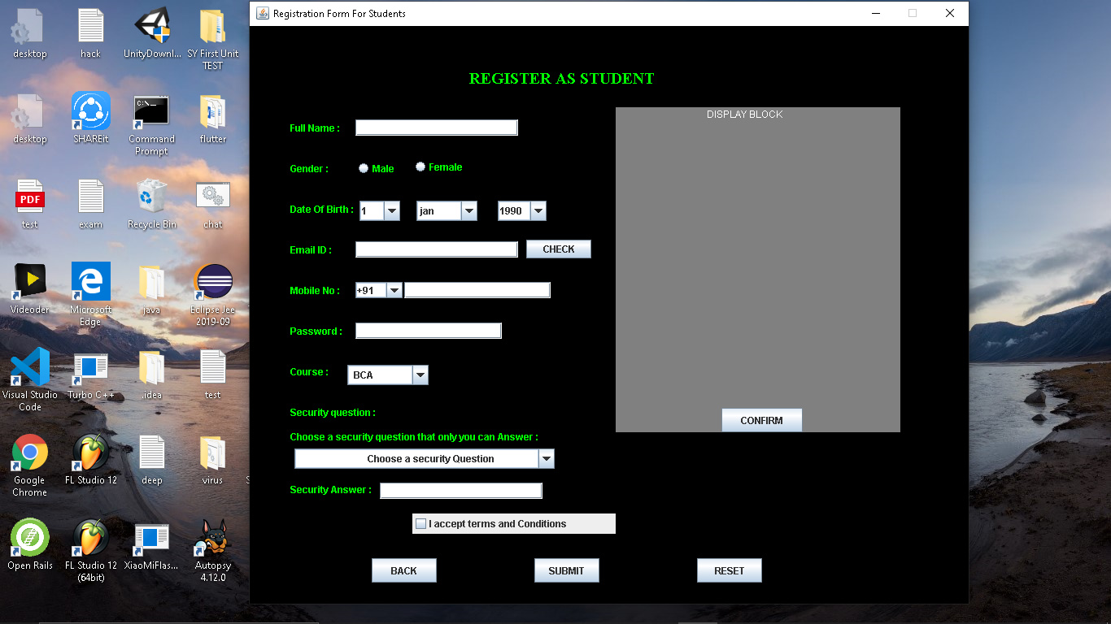
Screen-Shots

Slide 11
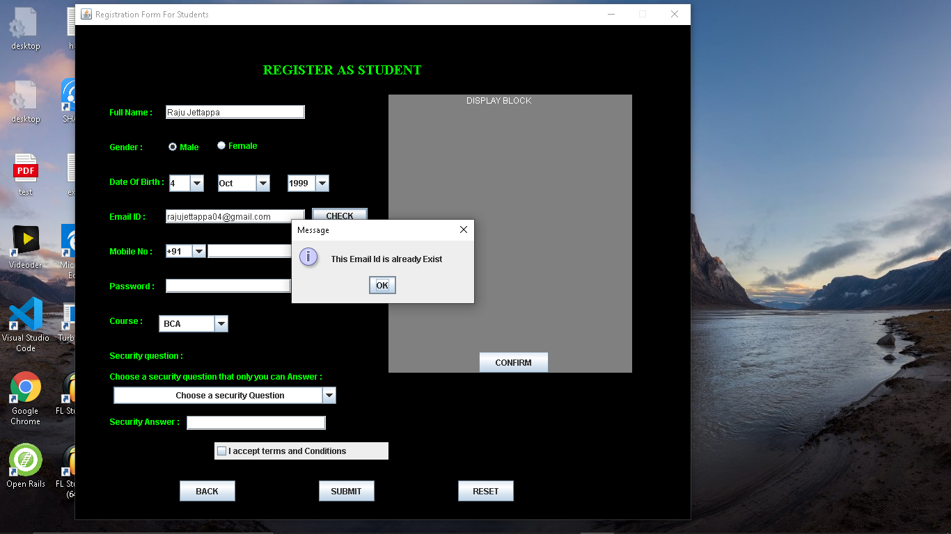

Screen-Shots

Slide 12
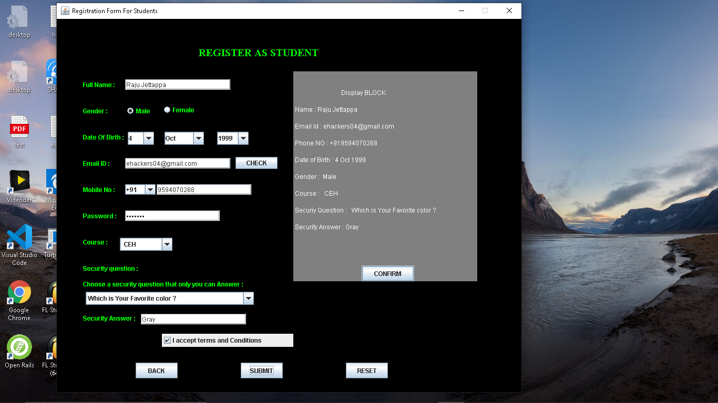

Screen-Shots

Slide 13

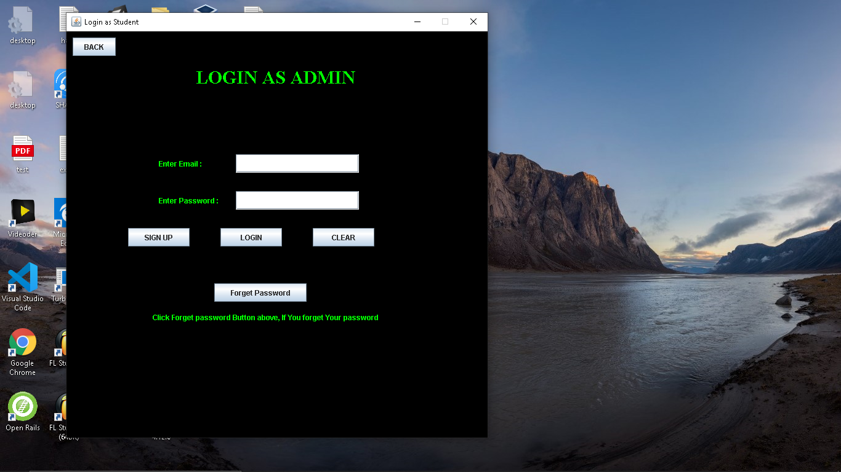
Screen-Shots

Slide 14
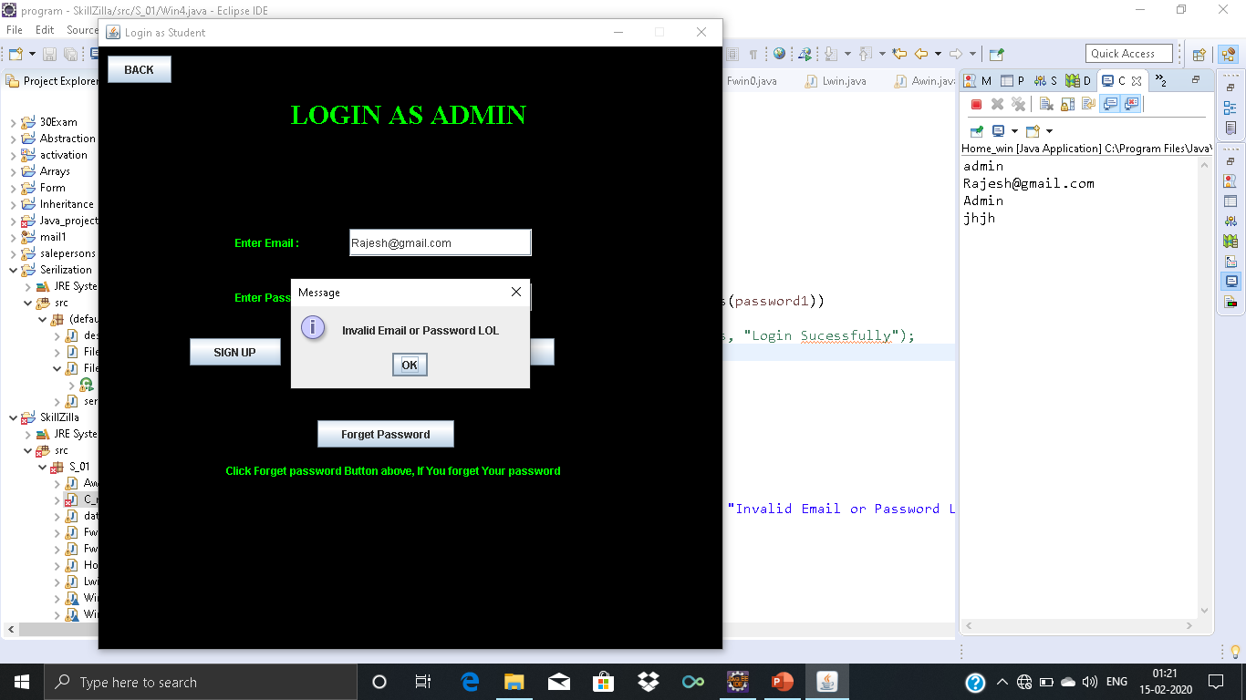
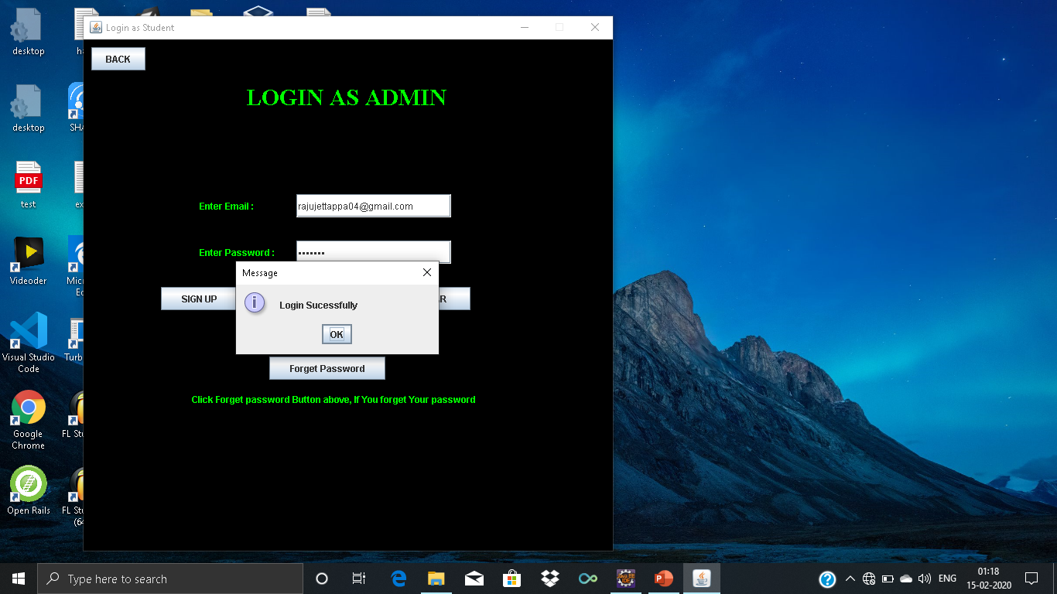
Screen-Shots

Slide 15
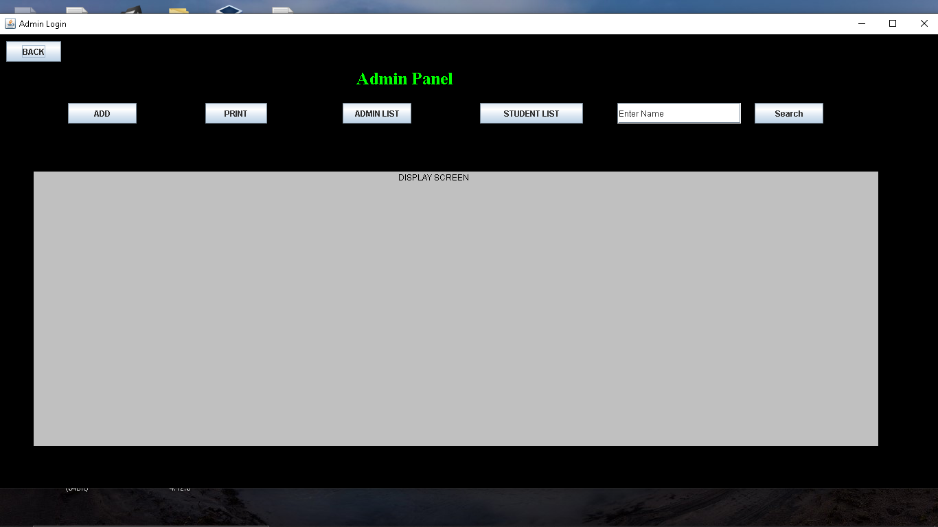
Screen-Shots

Slide 16
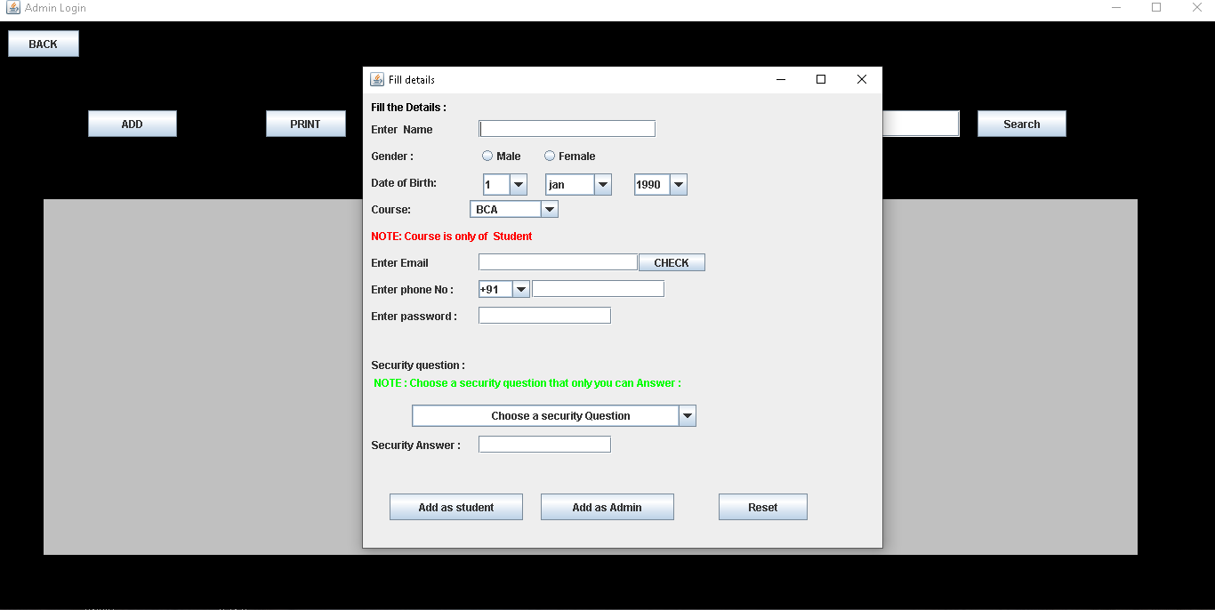
Screen-Shots

Slide 17
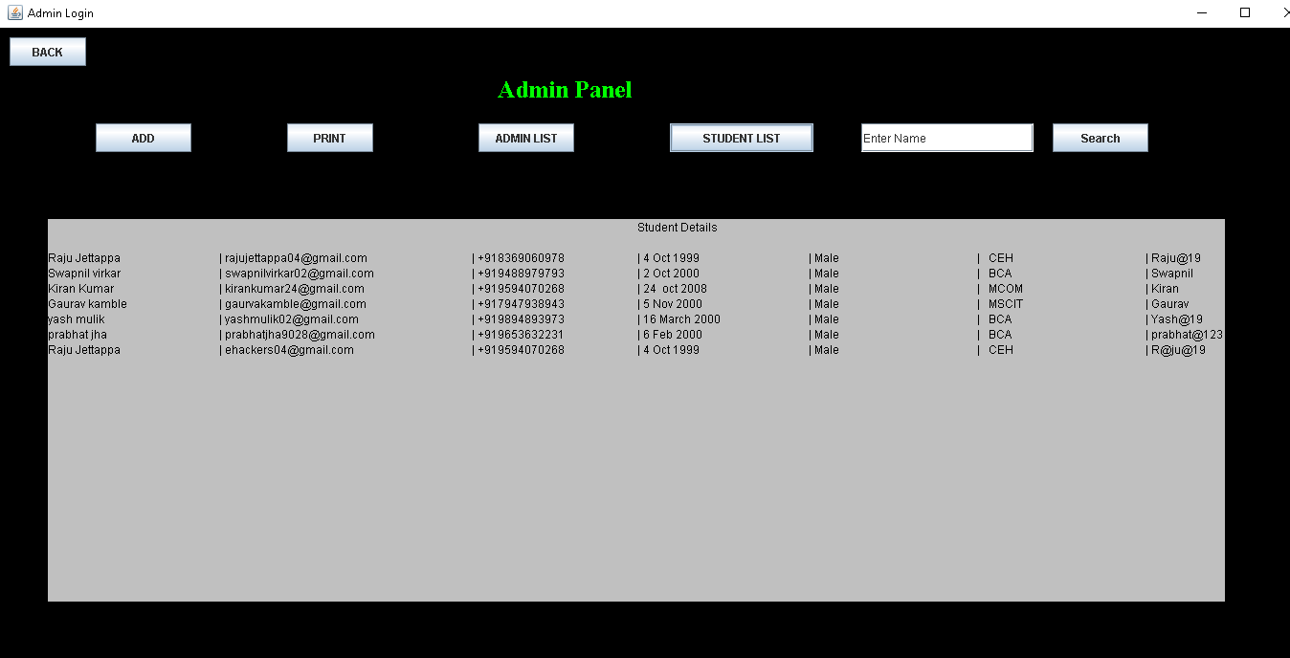
Screen-Shots

Slide 18
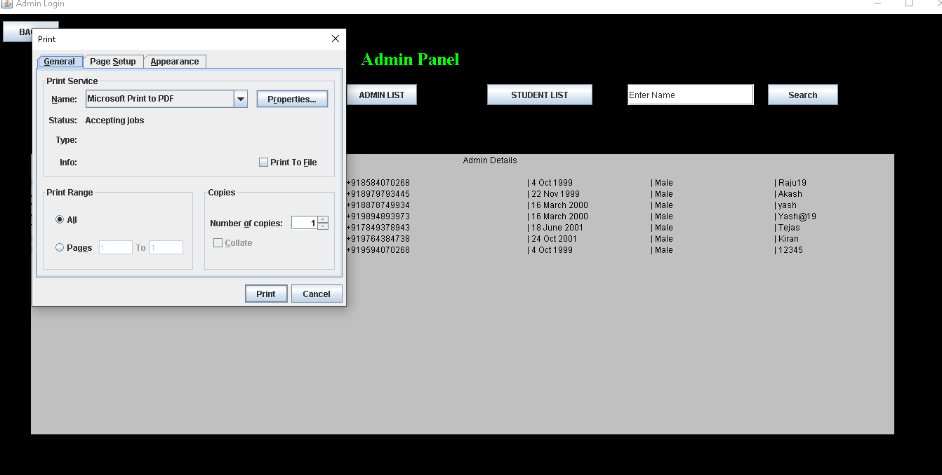
Screen-Shots

Slide 19

Screen-Shots

Slide 20
Future Scope
We can run entire system in any operating system.
And also we will have an android application of this entire system.
We will see the entire system more interactive

Slide 21
Reference
www.javatpoint.com
www.tutorialspoint.com
www.stackoverflow.com

Slide 22
Thank you

